Slide 1

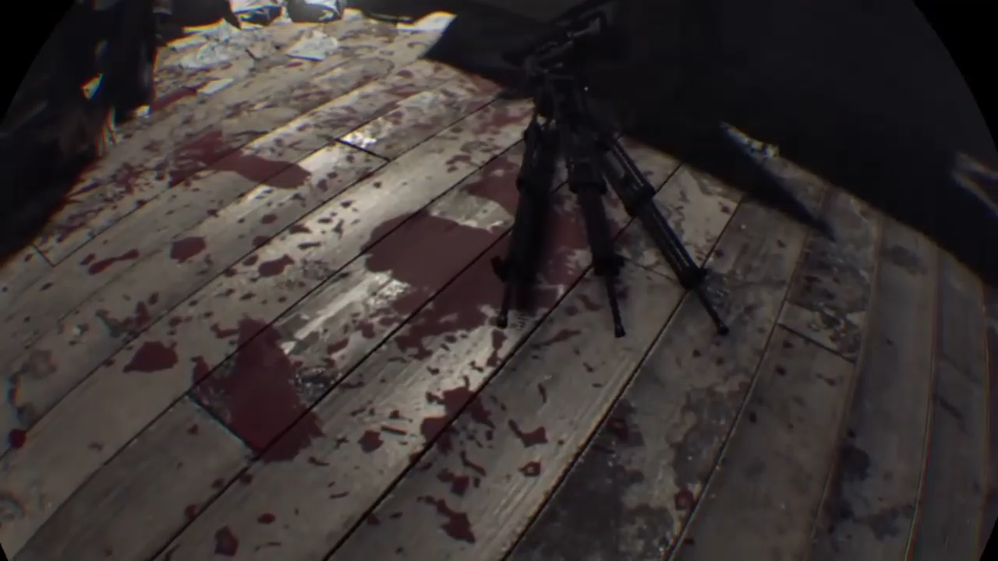

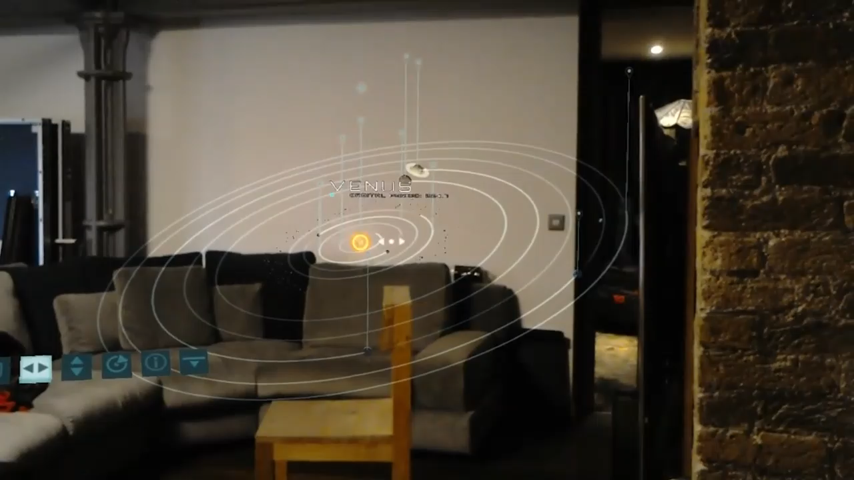
WHAT IS THE DIFFERENCE BETWEEN VR, AR ,MR?
WHAT IS THE DIFFERENCE BETWEEN VR, AR ,MR?
WHAT IS THE DIFFERENCE BETWEEN VR, AR ,MR?
VIRTUAL REALITY IMMERSES USERS IN A FULLY ARTIFICIAL DIGITAL ENVIRONMENT. THE MOST ADVANCED VR’S CAN EVEN PROVIDE FREEDOM OF MOVEMENT AND USERS CAN MOVE IN A DIGITAL ENVIRONAMENT AND EVEN HEAR SOUNDS TOO.
SIMPLY PUT, in mixed reality you can see virtual objects just like you can in augmented reality, but these objects can also interact with the real world. In a sense, mixed reality is a more immersive and interactive type of augmented reality.
VIRTUAL REALITY IMMERSES USERS IN A FULLY ARTIFICIAL DIGITAL ENVIRONMENT. THE MOST ADVANCED VR’S CAN EVEN PROVIDE FREEDOM OF MOVEMENT AND USERS CAN MOVE IN A DIGITAL ENVIRONAMENT AND EVEN HEAR SOUNDS TOO.
AUGMENTED REALITY ATTACHES OR ADDS VIRTUAL ELEMENTS TO THE REAL WORLD. In other words, if you see the real world supplemented with digital objects, that’s Augmented reality.
SIMPLY PUT, in mixed reality you can see virtual objects just like you can in augmented reality, but these objects can also interact with the real world. In a sense, mixed reality is a more immersive and interactive type of augmented reality.
AUGMENTED REALITY ATTACHES OR ADDS VIRTUAL ELEMENTS TO THE REAL WORLD. In other words, if you see the real world supplemented with digital objects, that’s Augmented reality.
VIRTUAL REALITY IMMERSES USERS IN A FULLY ARTIFICIAL DIGITAL ENVIRONMENT. THE MOST ADVANCED VR’S CAN EVEN PROVIDE FREEDOM OF MOVEMENT AND USERS CAN MOVE IN A DIGITAL ENVIRONAMENT AND EVEN HEAR SOUNDS TOO.
AUGMENTED REALITY ATTACHES OR ADDS VIRTUAL ELEMENTS TO THE REAL WORLD. In other words, if you see the real world supplemented with digital objects, that’s Augmented reality.
SIMPLY PUT, in mixed reality you can see virtual objects just like you can in augmented reality, but these objects can also interact with the real world. In a sense, mixed reality is a more immersive and interactive type of augmented reality.

